Slide 1
Notes:
Good evening.
My name is Jessica McVary, and I am a Planning Supervisor with Montgomery Planning’s Midcounty Master Plan Team. I am really pleased to be here with you tonight to provide an overview of Montgomery Planning and highlight some recent, current, and upcoming plans and studies in the mid-county.

Slide 2
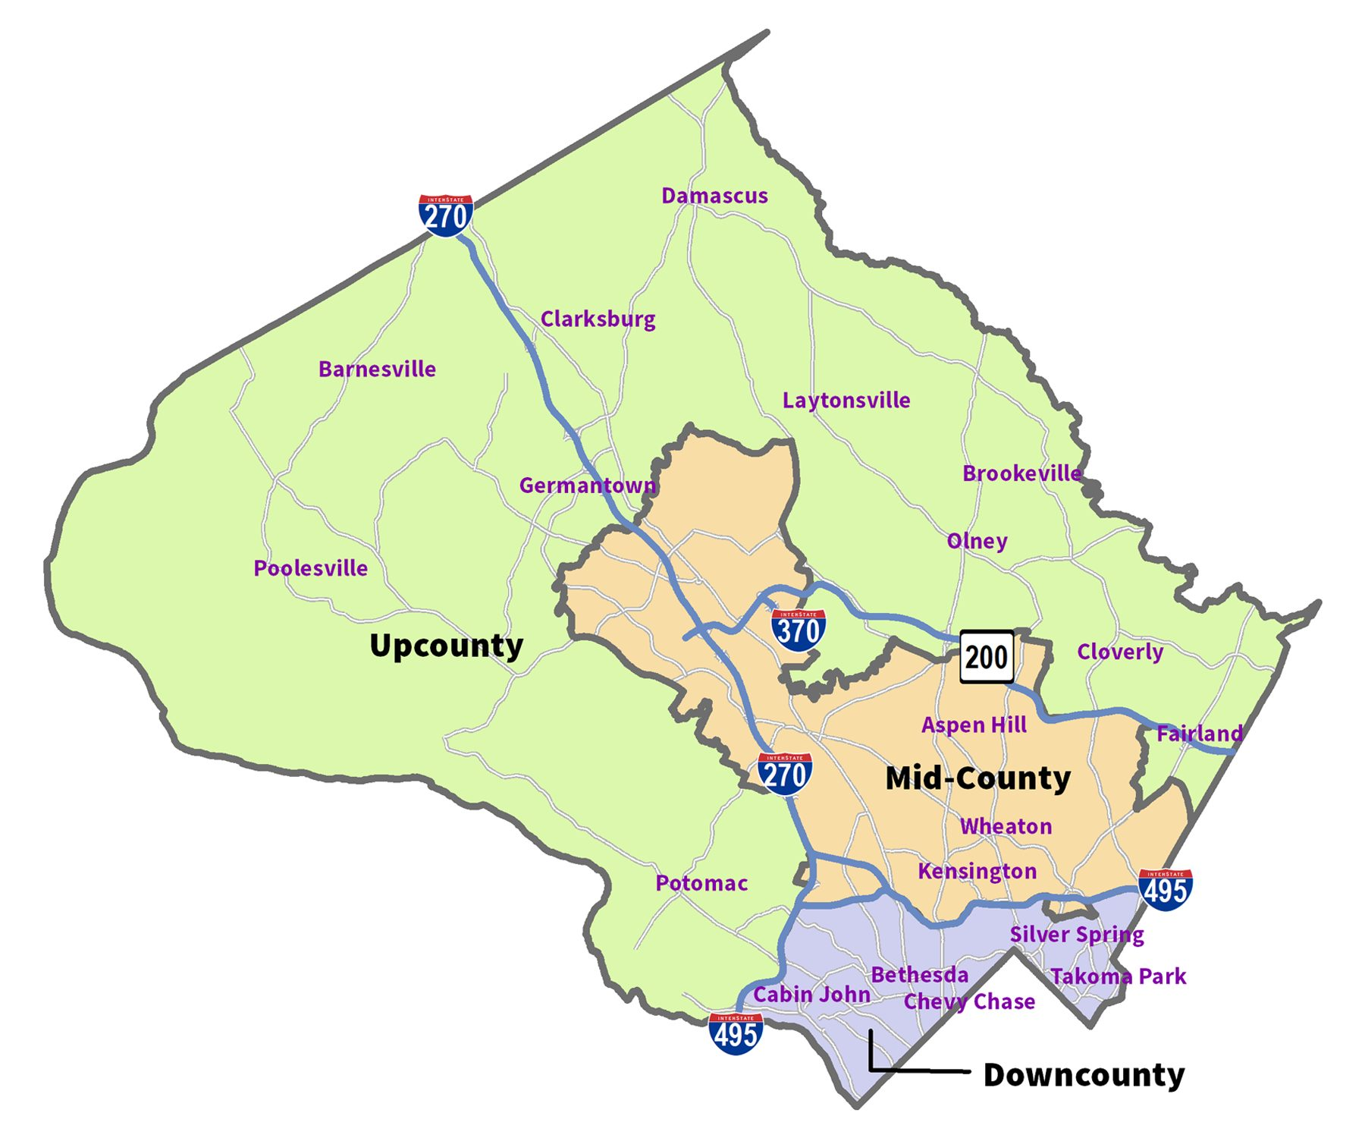
Agenda
Introductions
Montgomery Planning Intro
Master Plan Process and Limitations
WOSG Master Plan
Implementation Status
Questions
Notes:
As you may know, Montgomery Planning is a department of the Maryland-National Capital Park and Planning Commission, which is a state agency. Also known as M-NCPPC, the Commission is the organization behind the brown signs that you see around the county, especially in parks.
Montgomery Planning operates in multi-disciplinary geographic teams with community planning and regulatory functions. As you can see in the map on this slide, these divisions are Downcounty, Midcounty, and Upcounty. Our geographic divisions do not entirely align with the county’s regional services areas. For example, the Mid-County Regional Services Area falls within Montgomery Planning’s Midcounty and Upcounty Planning Divisions.
In addition to our three geographic teams, we also have several other divisions including:
Countywide Planning and Policy
Research and Strategic Projects.
(Information Technology and Innovation
Strategic Communications
Intake and Regulatory Coordination
Management Services; and
Office of the Planning Director/Planning Policy and Special Projects)

Slide 3
Montgomery Planning – Who We Are
Part of the Maryland-National Capital Park and Planning Commission (M-NCPPC)
Organized in multi-disciplinary geographic teams as well as several other divisions including Countywide Planning and Policy and Research and Strategic Projects.
Notes:
As you may know, Montgomery Planning is a department of the Maryland-National Capital Park and Planning Commission, which is a state agency. Also known as M-NCPPC, the Commission is the organization behind the brown signs that you see around the county, especially in parks.
Montgomery Planning operates in multi-disciplinary geographic teams with community planning and regulatory functions. As you can see in the map on this slide, these divisions are Downcounty, Midcounty, and Upcounty. Our geographic divisions do not entirely align with the county’s regional services areas. For example, the Mid-County Regional Services Area falls within Montgomery Planning’s Midcounty and Upcounty Planning Divisions.
In addition to our three geographic teams, we also have several other divisions including:
Countywide Planning and Policy
Research and Strategic Projects.
(Information Technology and Innovation
Strategic Communications
Intake and Regulatory Coordination
Management Services; and
Office of the Planning Director/Planning Policy and Special Projects)

Slide 4
Montgomery Planning – What We Do
Develop plans and establish policies for the natural and built environments for current and future generations.
Land use and transportation planning strategies;
Community and countywide plans;
Review of development applications;
Updates to land use and zoning regulations;
Cutting-edge research; and
Historic preservation.
Notes:
Montgomery Planning develops plans and establishes policies for the natural and built environment for current and future generations. We do this through several functions including:
Land use and transportation planning strategies;
Community and countywide plans;
Review of development applications;
Updates to land use and zoning regulations;
Research; and
Historic preservation.

Slide 5
Master or Sector Plans
Master Plans create a vision for the future with specific recommendations to help implement that vision.
Master Plans seek to:
Engage the community to define a vision
Prepare land use and zoning recommendations
Prepare recommendations on transportation infrastructure, environmental assets, community facilities
Support and prioritize equity
Serve as a guide for future development
Incorporate county policy guidance from Climate Action Plan, Vision Zero Resolution, among others
Master Plans cannot:
Ensure redevelopment or reinvestment occurs
Bring specific retailers / commercial uses to an area
Revoke existing approvals for development
Require adjacent property owners to consolidate land
Fund capital improvement projects
Address roadway operational issues (stop lights, stop signs, etc.)
Address code enforcement / crime

Slide 6
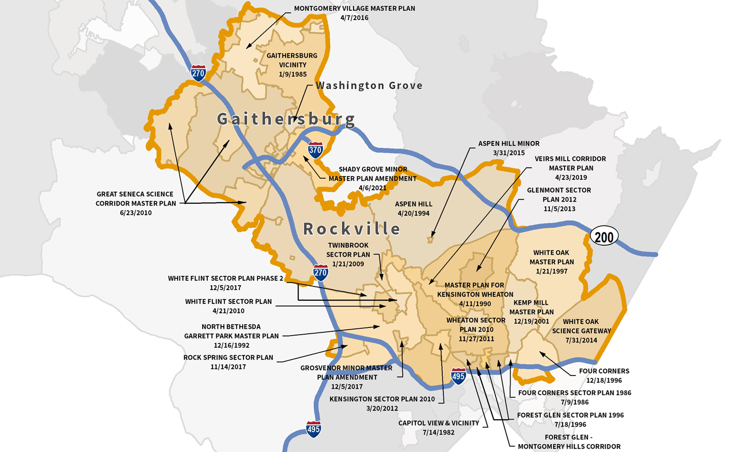
Midcounty Planning Division
White Oak Science Gateway MP
Notes:
I’d like to take just a few minutes to mention a few recent, current and upcoming plans and studies in Montgomery Planning’s Midcounty Division, which is shown in the map on the screen.

Slide 7
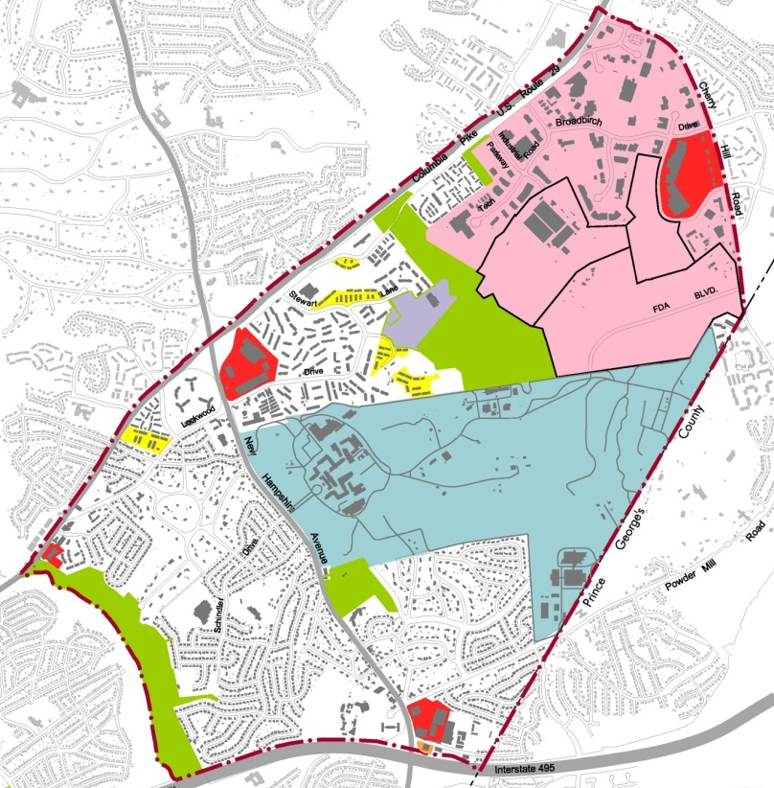
White Oak Science Gateway
Purpose
Leverage FDA and the FRC to promote mixed-use development at existing commercial centers.
Provide more employment opportunities in the Eastern County.
Implement the County’s vision to create a Life Sciences Center

Slide 8
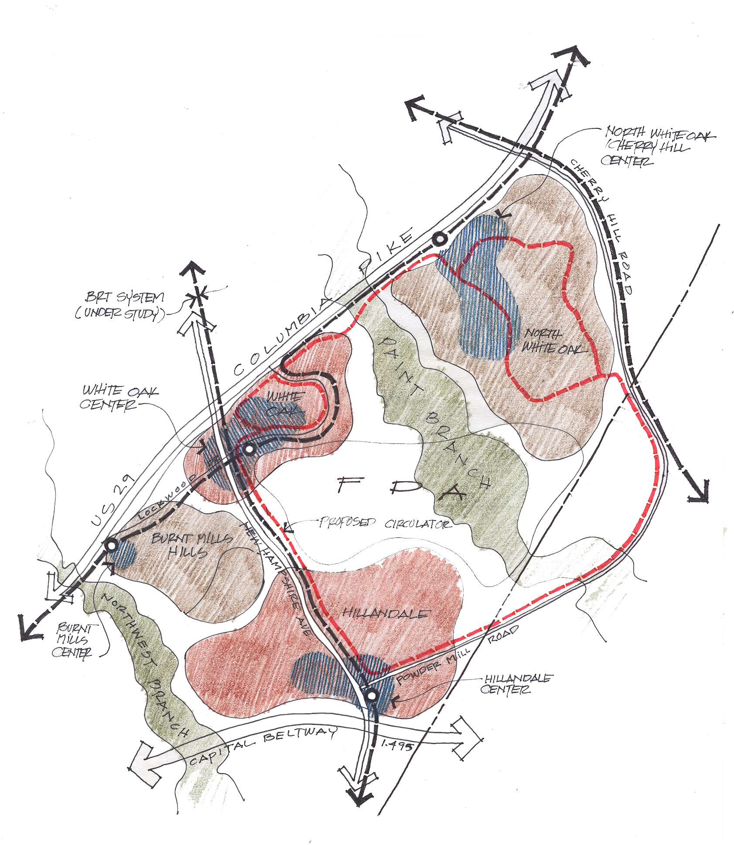
Master Plan Strategies
Revitalize older auto centric centers with mixed-use developments to serve as local community centers
Develop the Life Sciences Center as a new Town Center for East County
Connect all centers to transit around FDA via the recommended BRT and Circulator systems
BRT
Circulator

Slide 9
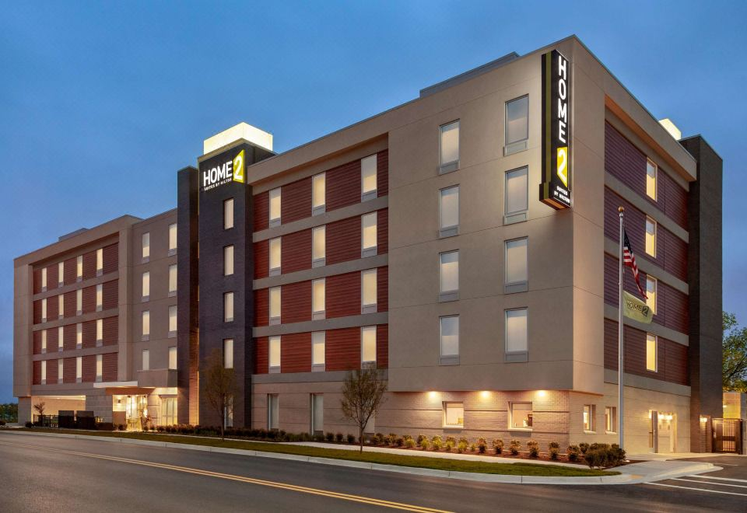
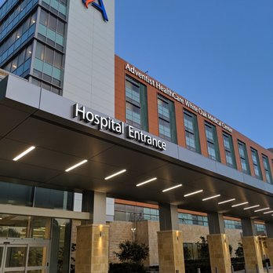
Implementation
Home 2 Suites by Hilton
Adventist Hospital
White Oak Town Center
FDA Master Plan Update
Transit improvements
100 Rooms
198 Patient Rooms
105,000 sf Commercial
±18,000 Employees

Slide 10
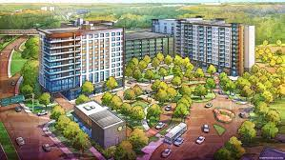
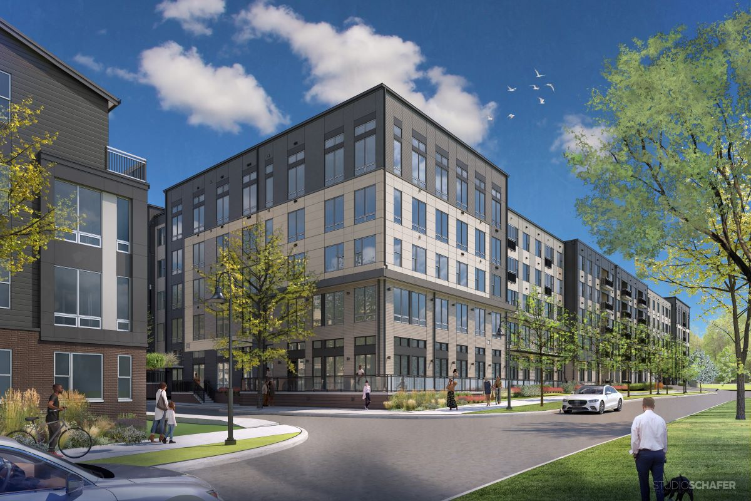
In Progress
Viva White Oak
Sketch Plan 2017
Preliminary Plan 2018
Hillandale Gateway
Site Plan 2021
White Oak Apartments
Site Plan 2022
White Oak Storage
Conditional Use 2022
463 DU’s
±71,000 sf Commercial
±12 Mil Non Res sf
(±6 Mil Res sf)
387 DU’s

Slide 11
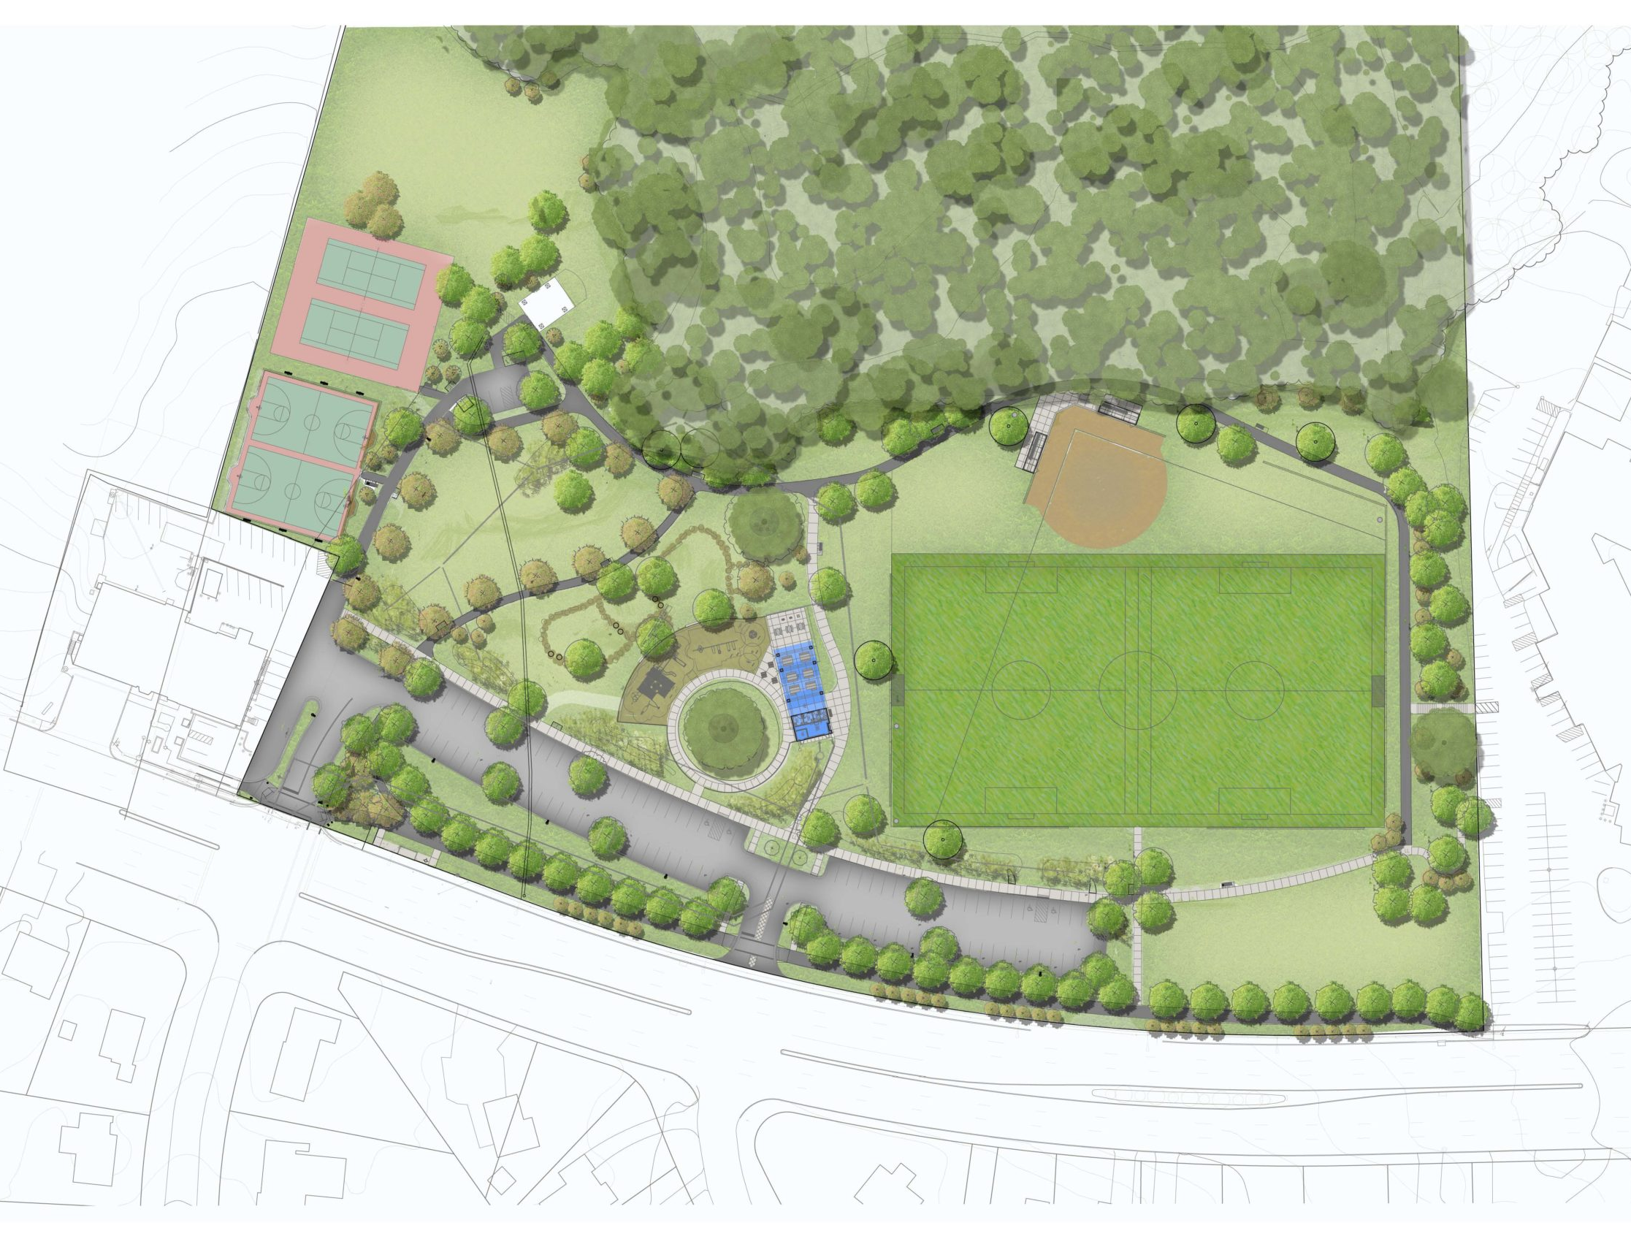
Local Parks
Hillandale Local Park
Under Construction - Anticipated reopening: September 2023
Stonehedge Local Park
in Design Phase - Anticipated construction start: Fall 2024

Slide 12
Questions?
Luis Estrada
Planner, Midcounty Planning Division
luis.estrada@montgomeryplanning.org
301.495.4641
Jessica McVary
Planning Supervisor, Midcounty Planning Division
jessica.mcvary@montgomeryplanning.org
301.495.4723

